Slide 1

Academic Session 2025-26
EVEN Semester Jan-Jun 2026
UNIVERSITY INSTITUTE OF ENGINEERING
DEPARTMENT NAME-UIE
PROGRAM NAME:-Bachelor of Engineering
SPECIALIZATION/ SEMESTER-6th
SUBJECT NAME:-Principles of Artificial Intelligence
(SUBJECT CODE-23CST-306)
Unit No.2 Chapter No.1 Lecture No.11 and 12
Topic :Informed and Uninformed Search Techniques in Artificial Intelligence
Faculty Name-Er.Parveen kumar saini and E_Code -13339 Designation-AP

Slide 2
1
Learning Objectives
Understanding the concept of search in Artificial Intelligence and differentiate between informed and uninformed search techniques.
Understanding the working principles, characteristics, and applications of major uninformed search algorithms (BFS, DFS) and informed search algorithms (Greedy Search, A* Search).
Understanding the efficiency, optimality, and completeness of informed and uninformed search algorithms and select an appropriate algorithm for a given problem.

Slide 3
2
Recap of Previous Lecture
Rules of Inference

Slide 4

3
Search in AI
Search is a problem-solving technique where AI explores states to reach a goal.
Search is a fundamental problem-solving technique in Artificial Intelligence (AI) where an intelligent agent systematically explores a set of possible states (called the state space) to find a sequence of actions that leads from an initial state to a goal state.
Additional / Recommended Readings:
https://www.geeksforgeeks.org/artificial-intelligence/difference-between-informed-and-uninformed-search-in-ai/
Figure-1 : AI search

Slide 5
4
Search in AI
In AI, many real-world problems—such as path finding, game playing, scheduling, and decision making—can be formulated as search problems.
Why Search is Needed in AI
An AI agent often does not know the solution in advance.
The agent must try different possibilities to reach the goal.
Search provides a structured way to explore alternatives and make decisions.
Additional / Recommended Readings:
https://www.geeksforgeeks.org/artificial-intelligence/difference-between-informed-and-uninformed-search-in-ai/

Slide 6
5
Search in AI(Key Components of a Search Problem)
Initial State:-The starting point of the problem.
Example: Starting city in a route-finding problem.
Goal State:-The desired state that the agent wants to reach.
Example: Destination city.
State Space:-The set of all possible states that can be reached from the initial state.
Actions / Operators:-The possible moves or actions that transition from one state to another.
Path:-A sequence of states from the initial state to the goal state.
Path Cost:-The cost associated with a path (distance, time, energy, etc.).
Additional / Recommended Readings:
https://www.geeksforgeeks.org/artificial-intelligence/difference-between-informed-and-uninformed-search-in-ai/

Slide 7
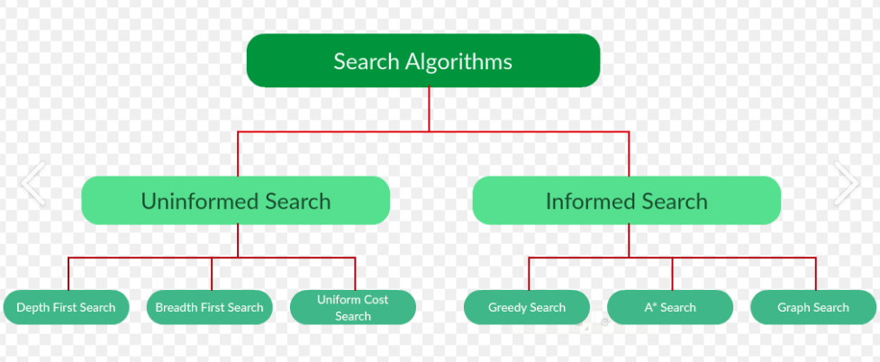
6
Search in AI
Search Algorithm:-
A search algorithm finds a path from initial state to goal state.
Additional / Recommended Readings:
https://www.geeksforgeeks.org/artificial-intelligence/difference-between-informed-and-uninformed-search-in-ai/
Figure-2 : Search Algorithms

Slide 8
State Space
7
State space is the set of all possible states from the initial state.

Slide 9
Uninformed Search
8
Uninformed search has no extra knowledge about the goal.

Slide 10
Blind Search
9
Blind search explores without knowing closeness to goal.

Slide 11
Features of Uninformed Search
10
No heuristics
Systematic exploration
Simple but inefficient

Slide 12
Breadth First Search
11
Explores level by level
Finds shortest path

Slide 13
Depth First Search
12
Explores deepest node first
Uses less memory

Slide 14
How Search Works in AI
13
The AI agent begins at the initial state.
It applies possible actions to generate new states.
These states are explored according to a search strategy.
The process continues until:
The goal state is found, or
The search space is exhausted.

Slide 15
Types of Search in AI
14
Based on the availability of information about the goal, search techniques are classified into:
1. Uninformed (Blind) Search
No additional knowledge about the goal.
Explores states systematically.
Examples:
Breadth-First Search (BFS)
Depth-First Search (DFS)

Slide 16
Types of Search in AI
15
2. Informed (Heuristic) Search
Uses extra information (heuristics) to guide the search.
More efficient and goal-directed.
Examples:
Greedy Best-First Search
A* Search

Slide 17
Heuristic Function
16
Heuristic estimates distance to goal
Heuristic function, denoted as h(n), is a function that: Estimates the cost of the cheapest path from a current node (state) n to the goal state.
It uses problem-specific knowledge to guide the search efficiently.

Slide 18
Heuristic Function
17
Purpose of a Heuristic FunctionThe main purposes are:
To reduce the search spaceTo speed up problem solvingTo guide the search toward the most promising statesWithout heuristics, AI must rely on uninformed (blind) search, which is slow and inefficient.

Slide 19
Features of Informed Search
18
Uses heuristics
Goal directed
Efficient

Slide 20
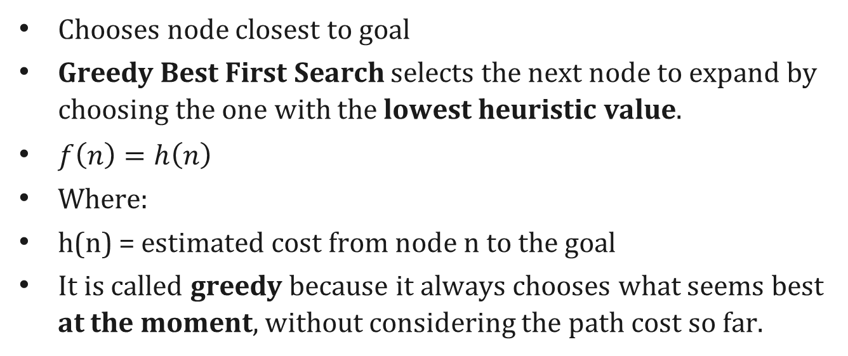
Greedy Best First Search
19
Chooses node closest to goal
Greedy Best First Search selects the next node to expand by choosing the one with the lowest heuristic value.
$f\left(n\right)=h\left(n\right)$
Where:
h(n) = estimated cost from node n to the goal
It is called greedy because it always chooses what seems best at the moment, without considering the path cost so far.

Slide 21
Key Idea of Greedy Best First Search
20
“Move towards the goal as quickly as possible.”
The algorithm ignores how expensive the path has been and focuses only on how close a node looks to the goal.

Slide 22
Search Algorithm
21
A* Search Algorithm
Uses path cost + heuristic
Optimal if heuristic admissible
AO* Algorithm:-Used for AND-OR graphs

Slide 23
Search Algorithm
22
Hill Climbing:-Moves toward better neighboring state
Admissible Heuristic:-Never overestimates actual cost
Consistent Heuristic:-Estimated cost always lower bound
Optimality:-Finds best solution
Completeness:-Always finds solution if exists

Slide 24
Informed vs Uninformed Search
23
Informed: fast & guided
Uninformed: slow & blind

Slide 25
Informed vs Uninformed Search
24
Parameters | Informed Search | Uninformed Search
Known as | It is also known as Heuristic Search. | It is also known as Blind Search.
Using Knowledge | It uses knowledge for the searching process. | It doesn't use knowledge for the searching process.
Performance | It finds a solution more quickly. | It finds solution slow as compared to an informed search.
Completion | It may or may not be complete. | It is always complete.
Cost Factor | Cost is low. | Cost is high.

Slide 26
Informed vs Uninformed Search
25
Parameters | Informed Search | Uninformed Search
Time | It consumes less time because of quick searching. | It consumes moderate time because of slow searching.
Direction | There is a direction given about the solution. | No suggestion is given regarding the solution in it.
Implementation | It is less lengthy while implemented. | It is more lengthy while implemented.
Efficiency | It is more efficient as efficiency takes into account cost and performance. The incurred cost is less and speed of finding solutions is quick. | It is comparatively less efficient as incurred cost is more and the speed of finding the Breadth-Firstsolution is slow.
Computational requirements | Computational requirements are lessened. | Comparatively higher computational requirements.

Slide 27
Informed vs Uninformed Search
26
Parameters | Informed Search | Uninformed Search
Size of search problems | Having a wide scope in terms of handling large search problems. | Solving a massive search task is challenging.
Examples of Algorithms | Greedy Search A* Search AO* Search Hill Climbing Algorithm | Depth First Search (DFS) Breadth First Search (BFS) Branch and Bound

Slide 28
Applications
27
Routing
Games
Robotics
Scheduling

Slide 29
Heuristic Search Techniques in AI
28
Heuristic search techniques are used for problem-solving in AI systems. These techniques help find the most efficient path from a starting point to a goal, making them essential for applications such as navigation systems, game playing, and optimization problems.
Heuristic search operates within the search space of a problem to find the best or near-optimal solution using systematic algorithms.
Unlike brute-force methods, which exhaustively evaluate all possible solutions, heuristic search leverages heuristic information to guide the search toward more promising paths.

Slide 30
Heuristic Search Techniques in AI
29
Heuristics refer to a set of criteria or rules of thumb that provide an estimate of the most viable solution. By balancing exploration (searching new possibilities) and exploitation (refining known solutions), heuristic algorithms efficiently solve complex problems that would otherwise be computationally expensive.
Significance of Heuristic Search in AI
The advantage of heuristic search techniques in AI is their ability to efficiently navigate large search spaces. By prioritizing the most promising paths, heuristics significantly reduce the number of possibilities that need to be explored. This not only accelerates the search process but also enables AI systems to solve complex problems that would be impractical for exact algorithms.

Slide 31
Components of Heuristic Search
30
Heuristic search algorithms typically comprise several essential components:
1.State Space: This implies that the totality of all possible states or settings, which is considered to be the solution for the given problem.
2.Initial State: The instance in the search tree of the highest level with no null values, serving as the initial state of the problem at hand.
3.Goal Test: The exploration phase ensures whether the present state is a terminal or consenting state in which the problem is solved.
4.Successor Function: This create a situation where individual states supplant the current state which represent the possible moves or solutions in the problem space.
5.Heuristic Function: The function of a heuristic is to estimate the value or distance from a given state to the target state. It helps to focus the process on regions or states that has prospect of achieving the goal.

Slide 32
Types of Heuristic Search Techniques
31
Over the history of heuristic search algorithms, there have been a lot of techniques created to improve them further and attend different problem domains. Some prominent techniques include:
1. A* Search Algorithm
A* Search Algorithm is perhaps the most well-known heuristic search algorithm. It uses a best-first search and finds the least-cost path from a given initial node to a target node. It has a heuristic function, often denoted as �(�)=�(�)+h(�) , where g(n) is the cost from the start node to n, and h(n) is a heuristic that estimates the cost of the cheapest path from n to the goal. A* is widely used in pathfinding and graph traversal.
2. Greedy Best-First Search
Greedy best-first search expands the node that is closest to the goal, as estimated by a heuristic function. Unlike A*, which considers both path cost and estimated remaining cost, greedy best-first search only prioritizes the estimated cost to the goal. While this makes it faster, it can be less optimal, often leading to sub optimal solutions.

Slide 33
Types of Heuristic Search Techniques
32
Over the history of heuristic search algorithms, there have been a lot of techniques created to improve them further and attend different problem domains. Some prominent techniques include:
3. Hill Climbing
Hill climbing is a heuristic search used for mathematical optimization problems. It is a variant of the gradient ascent method. It starts from a random initial point and iteratively moves toward higher values (local maxima) by choosing the best neighboring state. However, it can get stuck in local maxima, failing to find the global optimum.
4. Simulated Annealing
Inspired by annealing in metallurgy, simulated annealing is a probabilistic technique for finding the global optimum. Unlike hill climbing, it allows the search to accept worse solutions temporarily to escape local optima. This probabilistic acceptance decreases over time, allowing it to converge toward the best solution.
5. Beam Search
Beam search is a graph-based search technique that explores only a limited number of promising nodes (a beam). The beam width, which limits the number of nodes stored in memory, plays a crucial role in the performance and accuracy of the search.

Slide 34
Applications of Heuristic Search
33
Heuristic search techniques are widely used in various real-world scenarios, including:
•Pathfinding: Whether it's navigating a city or plotting a route in a game, heuristic search helps find the shortest or most efficient path between two points.
•Optimization: From resource allocation to scheduling, heuristic methods help make the most of available resources while maximizing efficiency.
•Game Playing: In strategy games like chess and Go, AI relies on heuristic search to evaluate possible moves and plan ahead.
•Robotics: Autonomous robots use heuristic search to determine their movements, avoid obstacles, and complete tasks efficiently.
•Natural Language Processing (NLP): Search algorithms play a key role in language processing tasks like parsing, semantic analysis, and text generation, helping AI understand and generate human language.

Slide 35
34
Summary of the Lecture
Search is core of AI
Informed search is efficient
Difference between Informed and Uninformed Search.
Explain Heuristic Search Techniques in AI.

Slide 36
35
Next Lecture
Local Search Algorithms and Optimization Problems

Slide 37
36
Quiz/ FAQ’s
What is Search in AI?
What is Informed search?
What is uninformed search?
Informed vs Uninformed Search
Heuristic Search Techniques in AI

Slide 38
37
https://www.geeksforgeeks.org/artificial-intelligence/difference-between-informed-and-uninformed-search-in-ai/
https://www.geeksforgeeks.org/artificial-intelligence/informed-search-algorithms-in-artificial-intelligence/
https://www.geeksforgeeks.org/artificial-intelligence/uniformed-search-algorithms-in-ai/
https://www.geeksforgeeks.org/artificial-intelligence/heuristic-search-techniques-in-ai/
References/ Articles

Slide 39
38
Faculty-curated videos, NPTEL, Coursera, LinkedIn, or other relevant learning resources
https://www.youtube.com/watch?v=gZpUcsB9TFc
https://www.youtube.com/watch?v=FRBzy5-BR74

Slide 40

39
Class-Wise Feedback

Slide 41
40
Thank You
For queries
Email: parveen.e13339@cumail.in

